Slide 1
Outline
Networking Overview for Offensive Security
  Not a comprehensive coverage of networking
  But focuses on networking issues related and relevant to offensive security
  Today we will cover the data layer, link layer, and IP layer
  Next time we will cover the TCP layer and additional topics

Slide 2

The Internet
Designed as a research network
  Assumed that entities are basically trusted
It is designed as a network of networks
Notes:
Source of the image: http://www.unc.edu/~unclng/internet-map.gif

Slide 3
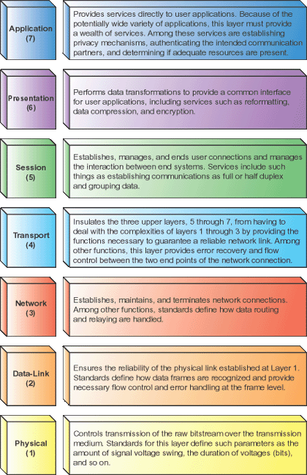
OSI Reference Model
The layers
  7: Application, e.g., HTTP, SMTP, FTP
  6: Presentation
  5: Session
  4: Transport, e.g. TCP, UDP
  3: Network, e.g. IP, IPX
  2: Data link, e.g., Ethernet frames, ATM cells
  1: Physical, e.g., Ethernet media, ATM media
Standard software engineering reasons for thinking about a layered design
Notes:
Image from http://technicals.files.wordpress.com/2007/10/osi02.gif?w=460

Slide 4
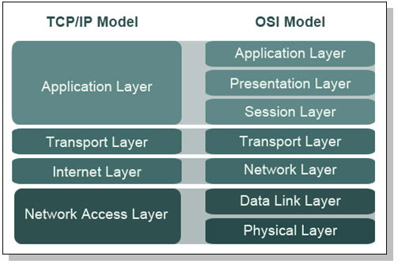
TCP/IP Model
Notes:
Image from http://webpage.pace.edu/ms16182p/networking/osi-model.jpg

Slide 5
Message Mapping to the Layers
L7 App
SVN update message
SP
SP
DP
DP
Segment 1
SP
DP
Segment 2
L4 TCP
SA
DA
SP
DP
Packet 1
SA
DA
SP
DP
Pack2
L3 IP
L2 Eth
SM
DM
SA
DA
SP
DP
Packet1
SM
DM
SA
DA
SP
DP
Pack2
Communications bit stream
Notes:
Ethernet communication is on frames

Slide 6
TCP/IP Model
Notes:
Image from http://webpage.pace.edu/ms16182p/networking/osi-model.jpg

Slide 7
Physical Layer and Its Security
This layer is the physical media, such as the wire, fiber, or air (for wireless) that information is actually transmitted across
  Classical confidentiality problems apply to wire tapping and other issues
  With wireless being widely used, wireless vulnerabilities and security are active topics

Slide 8
Hacking Hardware
Many out-of-the-box settings pose a security threat
  Eee PC 701 was exploitable out of the box by default
  Default passwords are available for a lot of the devices
    Due to a chicken-and-egg problem of how to communicate the initial device password to the user
  An attacker can use a cross-site response forgery to log in to the router and change the settings to redirect the users to a malicious DNS and other services

Slide 9
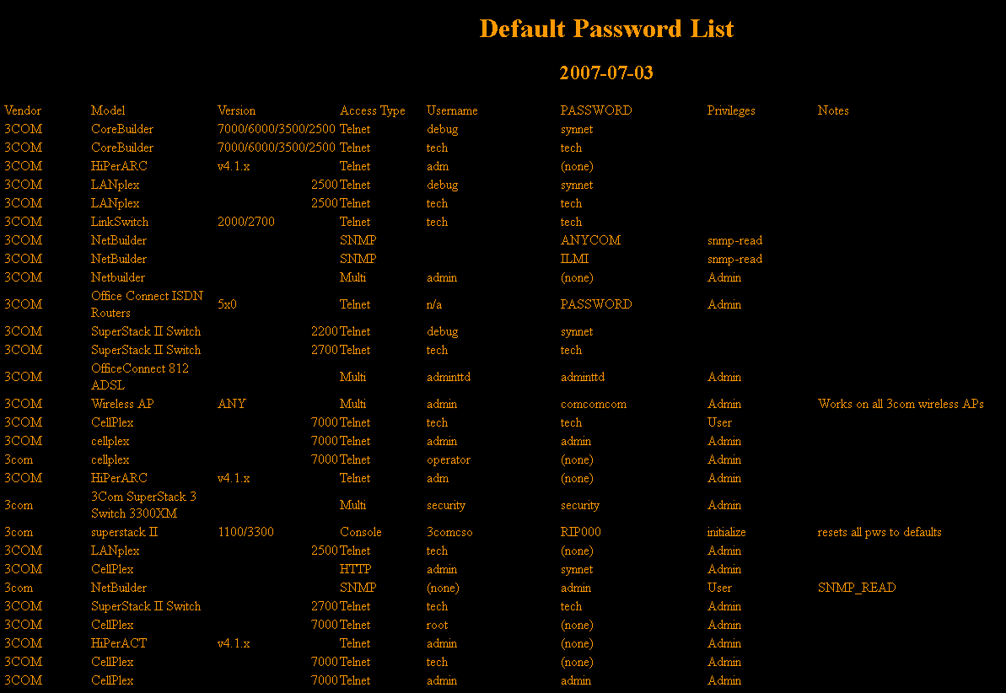
Default Passwords and Backdoor Accesses
Notes:
Downloaded from http://www.phenoelit-us.org/dpl/dpl.html .

Slide 10
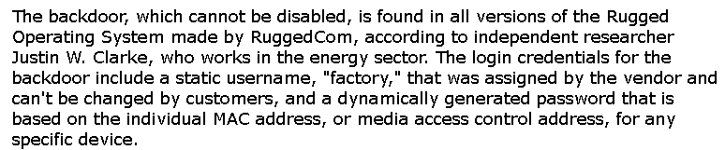
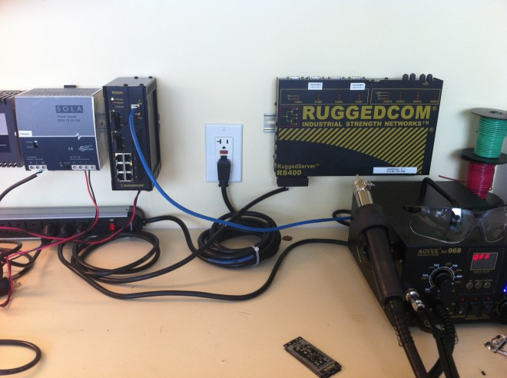
RuggedCom and Backdoor Accesses
Notes:
From http://www.wired.com/threatlevel/2012/04/ruggedcom-to-fix-vuln/

Slide 11
Data Link Layer and Its Security
There are different kinds of data link layer implementations
  Ethernet network
    Switches and hubs
    ARP cache poisoning
  Wireless network

Slide 12
Wireless Security
Most wireless networks today use the IEEE 802.11 standard
  Known as the wireless fidelity (Wi-Fi)
  Wireless networks use ISM radio bands (2.4 GHz and 5.0 GHz)
    Each band is divided into channels
  Two types of wireless networks: infrastructure and ad hoc

Slide 13
Basic Wireless Security Mechanisms
MAC Filtering
Hidden wireless networks
Responding to broadcast probe requests
Authentication
  WPA Pre-Shared Key (WPA-PSK)
  WPA Enterprise
Encryption
  WEP (Wired Equivalent Privacy)
  Temporal Key Protocol (TKIP)
  AES-CCMP

Slide 14
Wireless Hacking
Equipment
Discovery and monitoring
Denial of service attacks
  Built-in denial of service attacks
    An access point can force a client to disconnect
Encryption/decryption attacks
  WEP was broken but is still being used
Authentication attacks

Slide 15
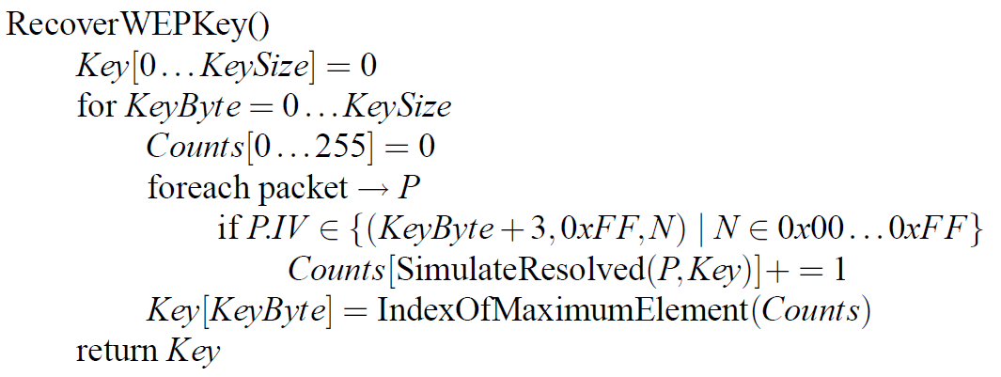
Attack of WEP
The following is an attack algorithm implemented
  To recover a 128-bit key, the number of packets needed is between 5,000,000 and 6,000,000

Slide 16
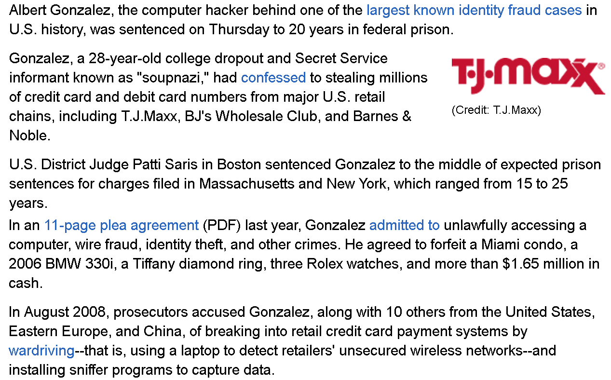
TJ MAXX Example

Slide 17
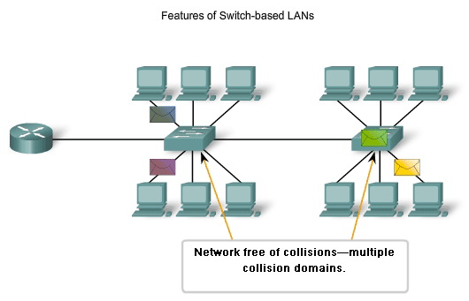
Ethernet Switches and Hubs

Slide 18
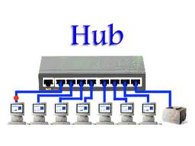
Ethernet Switches and Hubs

Slide 19
Network Layer - IP
Moves packets between computers
  Possibly on different physical segments
  Best effort
Technologies
  Routing
  Lower level address discovery (ARP)
  Error Messages (ICMP)

Slide 20
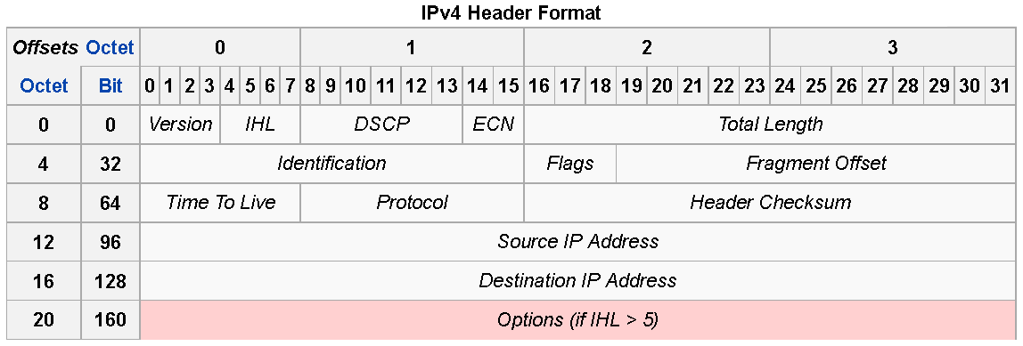
IPv4

Slide 21
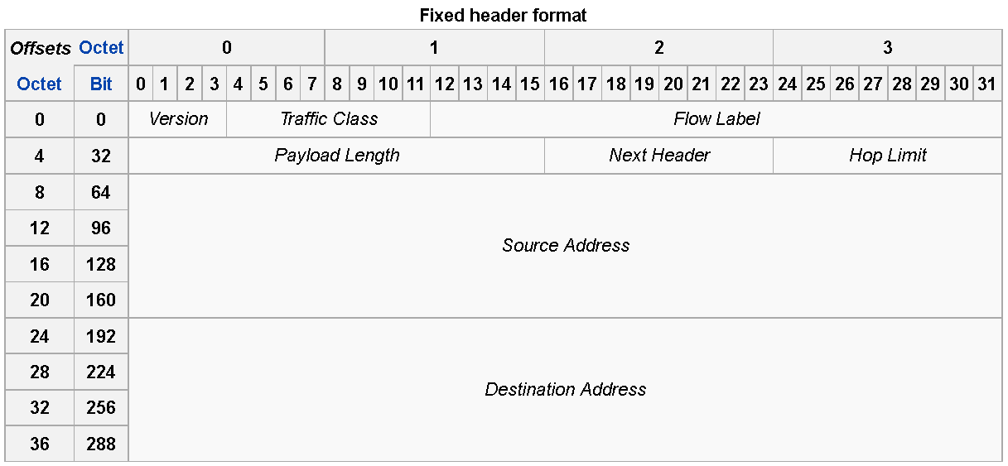
IPv6 Header Format
Notes:
From http://en.wikipedia.org/wiki/IPv6_packet
IPv6 packets consist of two parts, headers and payload. The fixed header is the first 40 octets of a packet; a packet can have extension headers and the last header points to the payload of the packet.

Slide 22
IPv4 header fields
Version - “4” standard (“6” for IPv6)
Header length - number of 32-bit words in hdr
  Minimum 5, maximum 15
Differentiated Services - codes for how to handle, likely to be used extensively for streaming, e.g., VOIP
Total length of packet, in bytes
Identification - used in sequencing fragments, underused, proposals for other functions, i.e., traceback
Flags (3 of them), 0, “don’t fragment”, “more fragments”
Fragment offset (in units of 8 bytes, from beginning)
TTL - maximum remaining allowed hops

Slide 23
IPv4 Header Fields
Protocol - code for protocol at transport layer, e.g., ICMP (1), IGMP(2), TCP(6), UDP(17), OSPF (89), SCTP(132) (table of allocated codes is large)
Header checksum - 1’s compliment of sum of 1’s compliment words in header
  Changes every time TTL changes!
Source address - (IP address, 32 bits for v4)
Destination address (IP address, 32 bits for v4)
Options - not often used

Slide 24
IPv4 Addressing
Each entity has at least one address
Addresses divided into subnetwork
  Address and mask combination
  192.168.1.0/24 or 10.0.0.0/8
  192.168.1.0 255.255.255.0 or 10.0.0.0 255.0.0.0
  192.168.1.0-192.168.1.255 or 10.0.0.0-10.255.255.255
Addresses in your network are “directly” connected
  Broadcasts should reach them
  No need to route packets to them

Slide 25
Address Spoofing
Sender can put any source address in packets he sends:
  Can be used to send unwelcome return traffic to the spoofed address
  Can be used to bypass filters to get unwelcome traffic to the destination
Reverse Path verification can be used by routers to broadly catch some spoofers

Slide 26
Address Resolution Protocol (ARP)
Used to discover mapping of neighbouring Ethernet MAC to IP addresses.
  Need to find MAC for 192.168.1.3 which is in your interface's subnetwork
  Broadcast an ARP request on the link
  Hopefully receive an ARP reply giving the correct MAC
  The device stores this information in an ARP cache or ARP table

Slide 27
ARP Cache Poisoning
Bootstrap problem with respect to security. Anyone can send an ARP reply
  The Ingredients to ARP Poison, http://www.airscanner.com/pubs/arppoison.pdf
Classic Man-in-the-middle attack
  Send ARP reply messages to device so they think your machine is someone else
  Can both sniff and hijack traffic
Solutions
  Encrypt all traffic
  Monitoring programs like arpwatch to detect mapping changes
    Which might be valid due to DHCP

Slide 28
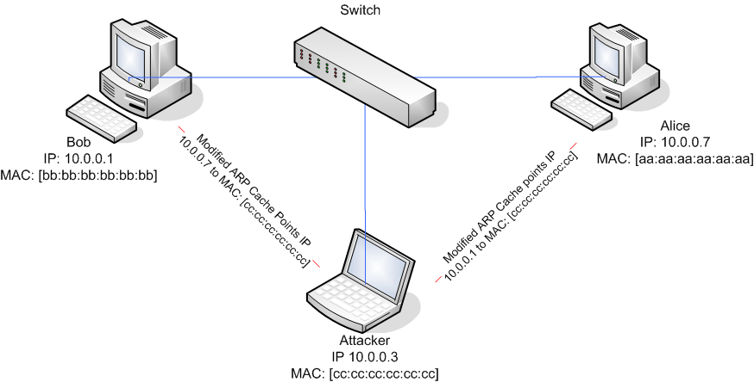
ARP Cache Poisoning

Slide 29
IPv4 Routing
How do packets on the Internet find their destination?
  Forwarding: each router decides where the packet should go next
  Routing: setting up forwarding rules in each router
Forwarding is “emergent” behavior
  Each router autonomously decides where a packet should go
  Routing tries to ensure that all these decisions in concert work well
Notes:
This is 438 terminology

Slide 30
Forwarding Tables
DIABLO
Internet
  128.186.120.2/21 if1
  192.168.80.145/21 if2
  192.168.122.170/16 if3
  0.0.0.0/0 if4
Most specific rule is used
Most hosts outside of the core have default rules
if4
if2
X123
FSU
Notes:
Forwarding tables are small, except at network core
\

Slide 31
Routing
How are forwarding tables set up?
Manual static routes
  Works well for small networks with default routes
Automatic dynamic routes
  OSPF / RIP (Routing Information Protocol) for internal routes
  BGP (Border Gateway Protocol) for external routes
Notes:
Why do we want to automatically set up these rules?
Why do they need to be dynamic?

Slide 32
BGP
Internet split up into Autonomous Systems (ASes)
Each AS advertises networks it can reach
  Aggregates networks from its neighbor ASes in advertisements
  Uses local policies to decide what to re-advertise
When setting up routes:
  Pick the most specific advertisement
  Use the shortest AS path
  Adjust with local policy
Notes:
What can go wrong?

Slide 33
Prefix Hijacking
Some ASes may advertise the wrong prefix
Case study: Pakistan Telecom
  Wanted to block YouTube
  Routes 208.65.153.0/24 to bit bucket
  Advertises route to rest of the world!
Problem:
  People close to Pakistan use the bad route
  People far away from Pakistan use bad route, too
    YouTube uses less specific advertisement, 208.65.152.0/22
Notes:
How would we prevent this type of attack?
Two key points: BGP is vulnerable, and misconfiguration is often as dangerous as attacks
People use this attacks for spam, etc.

Slide 34
BGP DoS
BGP uses TCP connection to communicate routes and test reachability
Attacks on TCP connections are possible
  Send reset
  Low-resource jamming
Result: cut arbitrary links on the Internet
  Easier than cutting cables!

Slide 35
Source Based Routing
In the IP Options field, can specify a source route
  Was conceived of as a way to ensure some traffic could be delivered even if the routing table was completely screwed up.
Can be used by the bad guy to avoid security enforcing devices
  Most folks configure routers to drop packets with source routes set

Slide 36
IP Options in General
Originally envisioned as a means to add more features to IP later
Most routers drop packets with IP options set
  Stance of not passing traffic you don’t understand
  Therefore, IP Option mechanisms never really took off
In addition to source routing, there are security Options
  Used for DNSIX, a MLS network encryption scheme

Slide 37
Internet Control Message Protocol (ICMP)
Used for diagnostics
  Destination unreachable
  Time exceeded, TTL hit 0
  Parameter problem, bad header field
  Source quench, throttling mechanism rarely used
  Redirect, feedback on potential bad route
  Echo Request and Echo reply, ping
  Timestamp request and Timestamp reply, performance ping
  Packet too big
Can use information to help map out a network
  Some people block ICMP from outside domain

Slide 38

Multihomed Hosts
A mutlihomed host is a host with multiple IP addresses
  Strong ES (End System) Model
  Weak ES Model

Slide 39
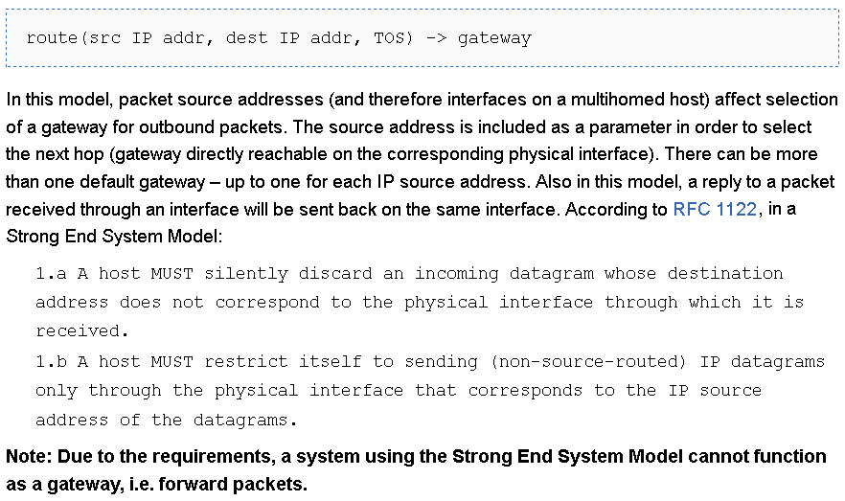
Strong ES Model
Notes:
Source: http://wiki.treck.com/Appendix_C:_Strong_End_System_Model_/_Weak_End_System_Model

Slide 40
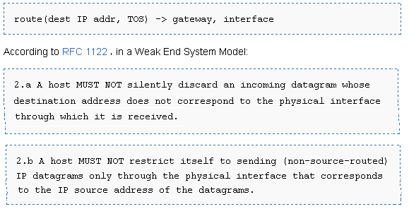
Weak ES Model

Slide 41
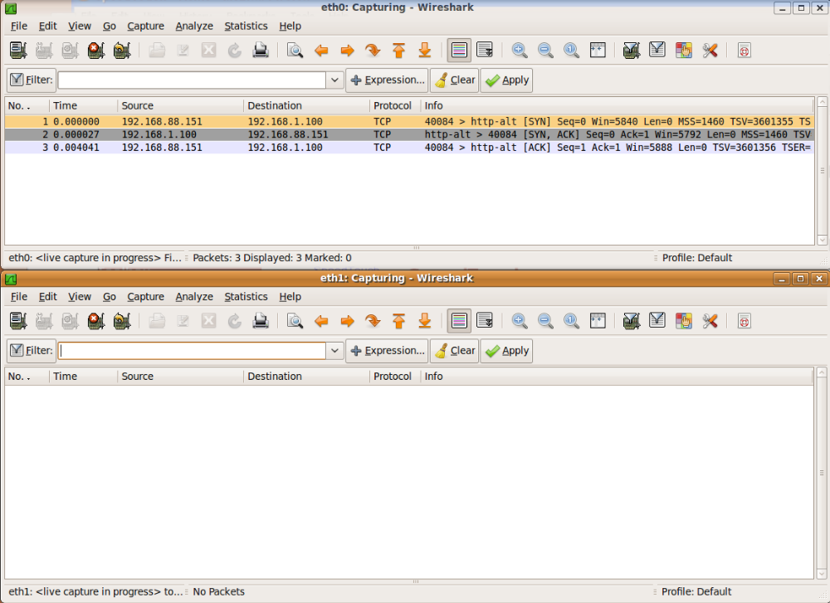
Remote Attacks Against SOHO Routers
Notes:
Source: https://www.defcon.org/images/defcon-18/dc-18-presentations/Heffner/DEFCON-18-Heffner-Routers.pdf
SOHO: Small Office / Home Office
Small Office/Home Office Router Security : http://www.us-cert.gov/reading_room/HomeRouterSecurity2011.pdf

Slide 42
Smurf Attack
An amplification DoS attack
  A relatively small amount of information sent is expanded to a large amount of data
Send ICMP echo request to IP broadcast addresses. Spoof the victim's address as the source
The echo request receivers dutifully send echo replies to the victim overwhelming it
Fraggle is a UDP variant of the same attack
  Parasmurf, a combination of Smurf and Fraggle attacks

Slide 43
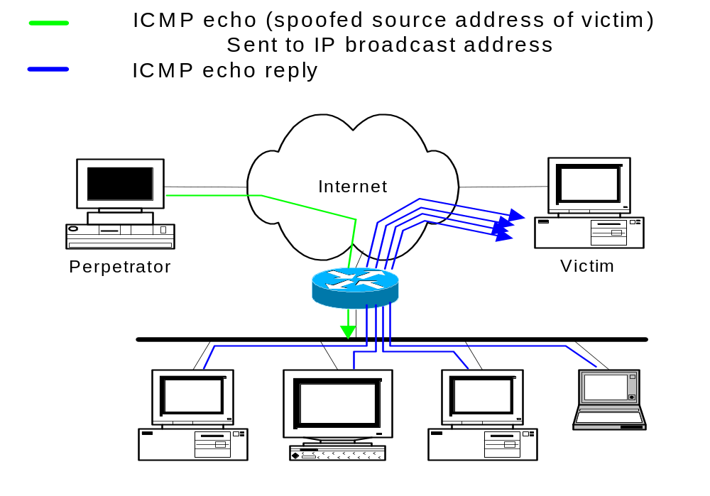
“Smurf”
Notes:
This is a diagram of a “Smurf” or “Fraggle” attack.
The single stream from the perpetrator to the broadcast LANrepresents the flow of information from the perpetrator to the broadcast LAN, usually several packets per second of ICMP echo (“Smurf”) or UDP echo (“Fraggle”) traffic spoofed to look like it is coming from the victim’s system.
If the router at the edge of the LAN forwards the broadcast ping to the LAN, each device on the LAN will respond with an echo-reply (ICMP) or will bounce the traffic (UDP), creating a multiplication of the original traffic flow. The traffic is then directed to the victim.
There are usually several bounce sites involved, used to increase the factor by which traffic is multiplied.
This attack is characterized by many ICMP echo reply packets at the victim’s site or many UDP packets involving the diagnostic “echo” port.

Slide 44
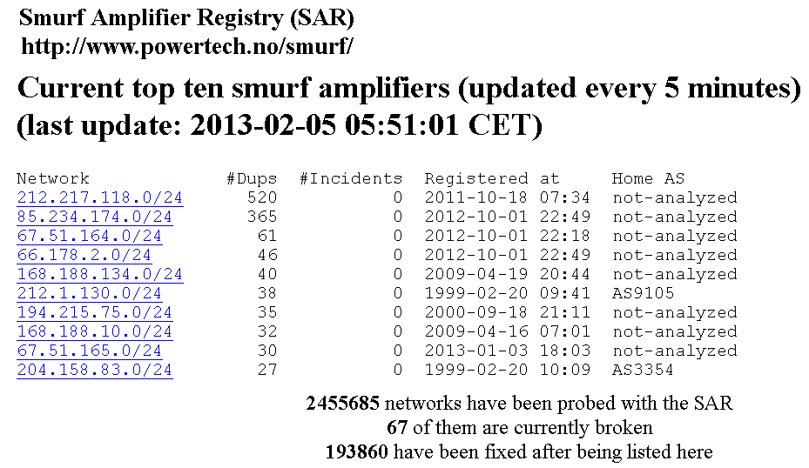
Smurf Amplifiers

Slide 45
Firewalls
Sits between two networks
  Used to protect one from the other
  Places a bottleneck between the networks
    All communications must pass through the bottleneck – this gives us a single point of control

Slide 46
Protection Methods
Packet Filtering
  Rejects TCP/IP packets from unauthorized hosts and/or connection attempts bt unauthorized hosts
Network Address Translation (NAT)
  Translates the addresses of internal hosts so as to hide them from the outside world
  Also known as IP masquerading
Proxy Services
  Makes high level application level connections to external hosts on behalf of internal hosts to completely break the network connection between internal and external hosts

Slide 47
Other Common Firewall Services
Encrypted Authentication
  Allows users on the external network to authenticate to the Firewall to gain access to the private network
Virtual Private Networking
  Establishes a secure connection between two private networks over a public network
    This allows the use of the Internet as a connection medium rather than the use of an expensive leased line

Slide 48
Additional services sometimes provided
Virus Scanning
  Searches incoming data streams for virus signatures so theey may be blocked
  Done by subscription to stay current
    McAfee / Norton
Content Filtering
  Allows the blocking of internal users from certain types of content.
    Usually an add-on to a proxy server
    Usually a separate subscription service as it is too hard and time consuming to keep current

Slide 49
Packet Filters
Compare network and transport protocols to a database of rules and then forward only the packets that meet the criteria of the rules
Implemented in routers and sometimes in the TCP/IP stacks of workstation machines
  in a router a filter prevents suspicious packets from reaching your network
  in a TCP/IP stack it prevents that specific machine from responding to suspicious traffic
    should only be used in addition to a filtered router not instead of a filtered router

Slide 50
Limitations of Packet Filters
IP addresses of hosts on the protected side of the filter can be readily determined by observing the packet traffic on the unprotected side of the filter
filters cannot check all of the fragments of higher level protocols (like TCP) as the TCP header information is only available in the first fragment.
  Modern firewalls reconstruct fragments then checks them
filters are not sophisticated enough to check the validity of the application level protocols imbedded in the TCP packets

Slide 51
Network Address Translation
RFC-1631
A short term solution to the problem of the depletion of IP addresses
  Long term solution is IP v6 (or whatever is finally agreed on)
  CIDR (Classless InterDomain Routing ) is a possible short term solution
  NAT is another
NAT is a way to conserve IP addresses
  Hide a number of hosts behind a single IP address
  Use:
    10.0.0.0-10.255.255.255,
    172.16.0.0-172.32.255.255 or
    192.168.0.0-192.168.255.255 for local networks

Slide 52
Translation Modes
Dynamic Translation (IP Masquerading)
  large number of internal users share a single external address
Static Translation
  a block external addresses are translated to a same size block of internal addresses
Load Balancing Translation
  a single incoming IP address is distributed across a number of internal servers
Network Redundancy Translation
  multiple internet connections are attached to a NAT Firewall that it chooses and uses based on bandwidth, congestion and availability.

Slide 53
Dynamic Translation (IP Masquerading )
Also called Network Address and Port Translation (NAPT)
Individual hosts inside the Firewall are identified based on of each connection flowing through the firewall.
  Since a connection doesn’t exist until an internal host requests a connection through the firewall to an external host, and most Firewalls only open ports only for the addressed host only that host can route back into the internal network
IP Source routing could route back in; but, most Firewalls block incoming source routed packets
NAT only prevents external hosts from making connections to internal hosts.
Some protocols won’t work; protocols that rely on separate connections back into the local network
Theoretical max of 2¹⁶ connections, actual is much less

Slide 54
Static Translation
Map a range of external address to the same size block of internal addresses
  Firewall just does a simple translation of each address
Port forwarding - map a specific port to come through the Firewall rather than all ports; useful to expose a specific service on the internal network to the public network

Slide 55
Load Balancing
A firewall that will dynamically map a request to a pool of identical clone machines
  often done for really busy web sites
  each clone must have a way to notify the Firewall of its current load so the Fire wall can choose a target machine
  or the firewall just uses a dispatching algorithm like round robin
Only works for stateless protocols (like HTTP)

Slide 56
Network Redundancy
Can be used to provide automatic fail-over of servers or load balancing
Firewall is connected to multiple ISP with a masquerade for each ISP and chooses which ISP to use based on client load
  kind of like reverse load balancing
  a dead ISP will be treated as a fully loaded one and the client will be routed through another ISP

Slide 57
Problems with NAT
Can’t be used with:
  protocols that require a separate back-channel
  protocols that encrypt TCP headers
  embed TCP address info
  specifically use original IP for some security reason

Slide 58
Services that NAT has problems with
H.323, CUSeeMe, VDO Live – video teleconferencing applications
Xing – Requires a back channel
Rshell – used to execute command on remote Unix machine – back channel
IRC – Internet Relay Chat – requires a back channel
PPTP – Point-to-Point Tunneling Protocol
SQLNet2 – Oracle Database Networking Services
FTP – Must be RFC-1631 compliant to work
ICMP – sometimes embeds the packed address info in the ICMP message
IPSec – used for many VPNs
IKE – Internet Key Exchange Protocol
ESP – IP Encapsulating Security Payload

Slide 59
Hacking through NAT
Static Translation
  offers no protection of internal hosts
Internal Host Seduction
  internals go to the hacker
    e-mail attachments – Trojan Horse virus’
    peer-to-peer connections
    hacker run porn and gambling sites
  solution = application level proxies
State Table Timeout Problem
  hacker could hijack a stale connection before it is timed out
  very low probability but smart hacker could do it
Source Routing through NAT
  if the hacker knows an internal address they can source route a packet to that host
    solution is to not allow source routed packets through the firewall

Slide 60
Proxies
Hides internal users from the external network by hiding them behind the IP of the proxy
Prevents low level network protocols from going through the firewall eliminating some of the problems with NAT
Restricts traffic to only the application level protocols being proxied
proxy is a combination of a client and a server; internal users send requests to the server portion of the proxy which then sends the internal users requests out through its client ( keeps track of which users requested what, do redirect returned data back to appropriate user)

Slide 61
Proxies
Address seen by the external network is the address of the proxy
Everything possible is done to hide the identity of the internal user
  e-mail addresses in the http headers are not propagated through the proxy<number>
Doesn’t have to be actual part of the Firewall, any server sitting between the two networks and be used

Slide 62
Content filtering
Since an enterprise owns the computing and network facilities used by employees, it is perfectly within it’s rights to attempt to limit internet access to sites that could be somehow related to business
  Since the proxy server is a natural bottle neck for observing all of the external requests being made from the internal network it is the natural place to check content
  This is usually done by subscription to a vendor that specializes in categorizing websites into content types based on observation
  Usually an agent is installed into the proxy server that compares URL requests to a database of URLs to reject
  All access are then logged and reported, most companies then review the reported access violations and usually a committee reviews and decides whether or not any personnel action should be taken (letter of reprimand, dismissal, ect)
  Sites that are usually filtered are those containing information about or pertaining to:
    Gambling
    Pornography

Slide 63
Virtual Private Networks (VPN)
Used to connect two private networks via the internet
  Provides an encrypted tunnel between the two private networks
  Usually cheaper than a private leased line but should be studied on an individual basis
  Once established and as long as the encryption remains secure the VPN is impervious to exploitation
  For large organizations using VPNs to connect geographically diverse sites, always attempt to use the same ISP to get best performance.
    Try to avoid having to go through small Mom-n-Pop ISPs as they will tend to be real bottlenecks

Slide 64
VPNs (more)
Many firewall products include VPN capabilities
But, most Operating Systems provide VPN capabilities
  Windows NT provides a point-to-point tunneling protocol via the Remote Access server
  Windows 2000 provides L2TP and IPSec
  Most Linux distributions support encrypted tunnels one way or another
    Point-to-Point Protocol (PPP) over Secure Sockets Layer (SSL)
Encrypted Authentication
  Many enterprises provide their employees VPN access from the Internet for work-at-home programs or for employees on-the-road
    Usually done with a VPN client on portable workstations that allows encryption to the firewall
      Good VPN clients disable connections to the internet while the VPN is running
      Problems include:
        A port must be exposed for the authentication
        Possible connection redirection
        Stolen laptops
        Work-at-home risks

Slide 65
Effective Border Security
For an absolute minimum level of Internet security a Firewall must provide all three basic functions
  Packet filtering
  Network Address translation
  High-level application proxying
Use the Firewall machine just for the firewall
  Won’t have to worry about problems with vulnerabilities of the application software
    If possible use one machine per application level server
      Just because a machine has a lot of capacity don’t just pile things on it.
        Isolate applications, a side benefit of this is if a server goes down you don’t lose everything
  If possible make the Firewall as anonymous as possible
    Hide the product name and version details, especially, from the Internet

Slide 66
Problems Firewalls Can’t Fix
Many e-mail hacks
  Remember how easy it is to spoof e-mail
Vulnerabilities in application protocols you allow
  Ex. Incoming HTTP requests to an IIS server
Modems
  Don’t allow users on the internal network to use a modem in their machine to connect to and external ISP (AOL) to connect to the Internet, this exposes everything that user is connected to the external network
  Many users don’t like the restrictions that firewalls place on them and will try to subvert those restrictions

Slide 67
Border Security Options
Filtered packed services
Single firewall with internal public servers
Single firewall with external public servers
Dual firewalls or DMZ firewalls
Enterprise firewalls
Disconnection

Slide 68
Filtered Packed Services
Most ISP will provide packet filtering services for their customers
  Issues:
    Remember that all of the other customers are also on the same side of the packet filter, some of these customers may also be hackers
    Does the ISP have your best interests in mind or theirs
    Who is responsible for reliability
    Configuration issues, usually at ISPs mercy
  Benefits:
    No up-front capital expenditures

Slide 69
Single firewall, internal public servers
Server
Customer
Web Server
Firewall
Router
Server
Hacker
Client
Mail Server
Hacker
Internal Private Network
External Private Network
External Public Network

Slide 70
Single firewall, internal public servers
Leaves the servers between the internal private network and the external network exposed
  Servers in this area should provide limited functionality
    No services/software they don’t actually need
  These servers are at extreme risk
    Vulnerable to service specific hacks – HTTP, FTP, Mail, …
    Vulnerable to low level protocol (IP, ICMP, TCP) hacks and DoS attacks

Slide 71
DMZ
Server
Customer
Web Server
Router
Firewall
Server
Hacker
Client
FTP
Server
Hacker
Internal Private Network
DMZ
External Public Network

Slide 72
Bastion Host
Many firewalls make use of what is known as a “bastion” host
  bastions are a host that is stripped down to have only the bare fundamentals necessary
    no unnecessary services
    no unnecessary applications
    no unnecessary devices
A combination of the “bastion” and its firewall are the only things exposed to the internet

Slide 73
Free Firewall Software Packages
IP Chains & IP Tables
  comes with most Linux distributions
SELinux (Security Enabled Linux – NSA)
  comes with some Linux distributions
    Fedora, RedHat
IPCop – specialized linux distribution

Slide 74
Home & Personal Routers
Provide
  configurable packet filtering
  NAT/DHCP
Linksys – single board RISC based linux computer
D-Link

Slide 75
Enterprise Firewalls
Check Point FireWall-1
Cisco PIX (product family)
MS Internet Security & Acceleration Server
GAI Gauntlet

Slide 76
IPsec
IPsec lives at the network layer
IPsec is transparent to applications
application
transport
network
link
physical
User
SSL
OS
IPsec
NIC

Slide 77
IKE and ESP/AH
Two parts to IPsec
IKE: Internet Key Exchange
  Mutual authentication
  Establish shared symmetric key
  Two “phases” ⎯ like SSL session/connection
ESP/AH
  ESP: Encapsulating Security Payload ⎯ for encryption and/or integrity of IP packets
  AH: Authentication Header ⎯ integrity only

Slide 78
IKE
IKE has 2 phases
  Phase 1 ⎯ IKE security association (SA)
  Phase 2 ⎯ AH/ESP security association
Phase 1 is comparable to SSL session
Phase 2 is comparable to SSL connection
Not an obvious need for two phases in IKE
If multiple Phase 2’s do not occur, then it is more expensive to have two phases!

Slide 79
IKE Phase 1 Summary
Result of IKE phase 1 is
  Mutual authentication
  Shared symmetric key
  IKE Security Association (SA)
But phase 1 is expensive (in public key and/or main mode cases)
Developers of IKE thought it would be used for lots of things ⎯ not just IPsec

Slide 80
IKE Phase 2
Phase 1 establishes IKE SA
Phase 2 establishes IPsec SA
Comparison to SSL
  SSL session is comparable to IKE Phase 1
  SSL connections are like IKE Phase 2
IKE could be used for lots of things
But in practice, it’s not!

Slide 81
IPsec
After IKE Phase 1, we have an IKE SA
After IKE Phase 2, we have an IPsec SA
Both sides have a shared symmetric key
  We want to protect IP datagrams

Slide 82
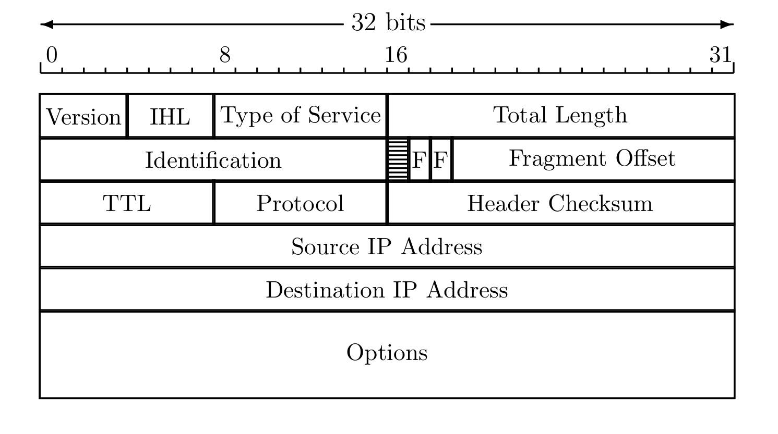
IP Review
IP datagram is of the form
IP header
data
Where IP header is

Slide 83
IP and TCP
Consider HTTP traffic (over TCP)
IP encapsulates TCP
TCP encapsulates HTTP
IP header
data
IP header
TCP hdr
HTTP hdr
app data
IP data includes TCP header, etc.

Slide 84
IPsec Transport Mode
IPsec Transport Mode
IP header
data
IP header
ESP/AH
data
Transport mode designed for host-to-host
Transport mode is efficient
  Adds minimal amount of extra header
The original header remains
  Passive attacker can see who is talking

Slide 85
IPsec Tunnel Mode
IPsec Tunnel Mode
IP header
data
new IP hdr
ESP/AH
IP header
data
Tunnel mode for firewall to firewall traffic
Original IP packet encapsulated in IPsec
Original IP header not visible to attacker
  New header from firewall to firewall
  Attacker does not know which hosts are talking

Slide 86
Comparison of IPsec Modes
Transport Mode
Transport Mode
  Host-to-host
Tunnel Mode
  Firewall-to-firewall
Transport mode not necessary
Transport mode is more efficient
IP header
data
IP header
ESP/AH
data
Tunnel Mode
IP header
data
new IP hdr
ESP/AH
IP header
data

Slide 87
IPsec Security
What kind of protection?
  Confidentiality?
  Integrity?
  Both?
What to protect?
  Data?
  Header?
  Both?
ESP/AH do some combinations of these

Slide 88
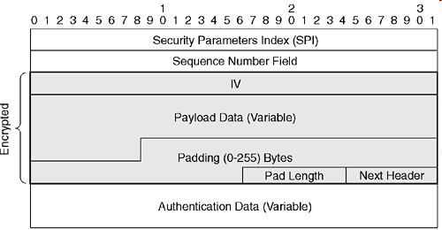
ESP Header Format

Slide 89
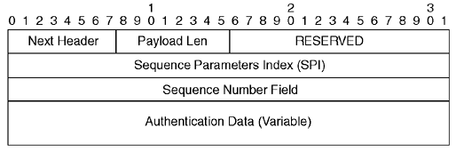
AH Header Format (not required for exams)

Slide 90
IPsec Summary
IPsec is a collection of protocols and mechanisms to provide confidentially, authentication, message integrity, and replay detection at the IP layer
  It consists of two parts, IKE and ESP/AH
  IPsec is complex as it is intended to be used for many applications
  There are also significant security flaws in design

